Slide 1



FOURIER ANALYSIS OF NUMERICAL INTEGRATION IN MONTE CARLO RENDERING
Kartic Subr Gurprit Singh Wojciech Jarosz
Heriot Watt University, Edinburgh
Dartmouth College
Dartmouth College
Notes:
As evident from the title, the central focus of this course is analysis of monte carlo algorithms, particularly sampling algorithms. There are two reasons that ssuch an analysis would be interesting …

Slide 2
Motivation for analysis
assess, compare existing methods for Monte Carlo rendering
provide insight, inspire improvement
Notes:
First, it would be nice to be able to compare and assess the different strategies proposed in the literature. In addition, it would be useful to provide insights that might lead to improved algorithms. For example by predicting errors associated with the sampling.
Over the years, may different physically based rendering methods have been proposed. Let’s say we wish to compare their relative accuracies. One way to do this would be to choose an arbitrary scene, render using various methods and compare the errors due to each method.

Slide 3
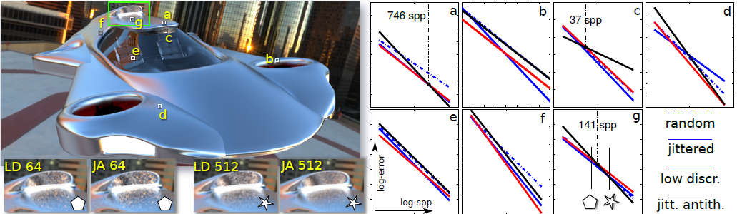
[Subr et al 2014]
Notes:
Over the years, may different physically based rendering methods have been proposed. Let’s say we wish to compare their relative accuracies. One way to do this would be to choose an arbitrary scene, render using various methods and compare the errors due to each method.

Slide 4
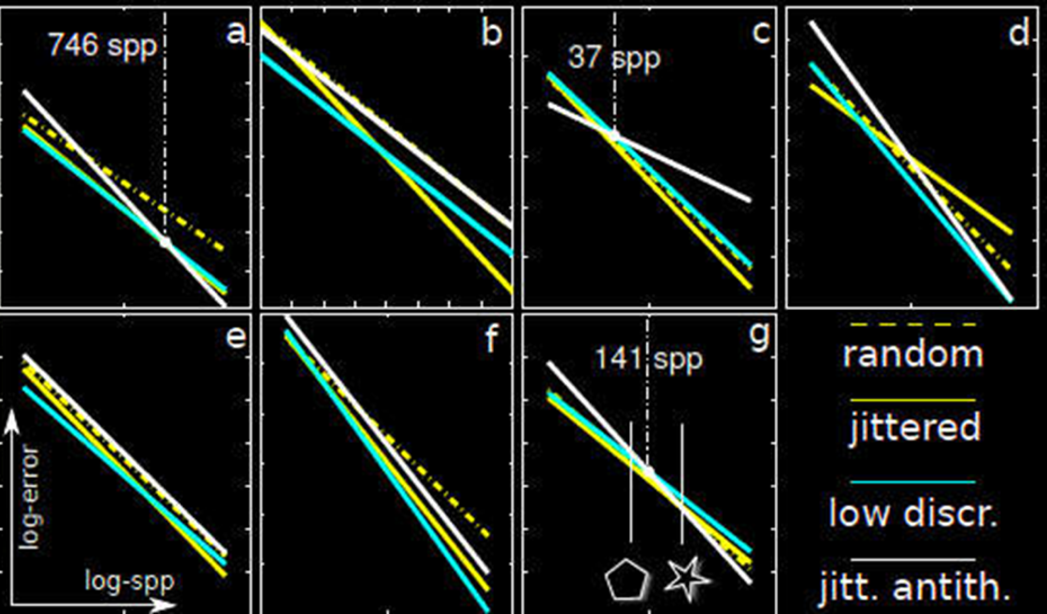
Error vs cost plots of rendering methods
method 1
method 2
[Subr et al 2014]
method 3
method 4

Slide 5
Error vs cost plots of rendering methods
method 4 is worst
method 4 is best
method 1
method 2
[Subr et al 2014]
method 3
method 4

Slide 6
Error vs cost plots of rendering methods
method 4 is best
method 4 is worst
method 1
method 2
[Subr et al 2014]
method 3
method 4

Slide 7

Course structure
30m
20m
Preliminaries
Sampling
30m
Formal treatment

Slide 8
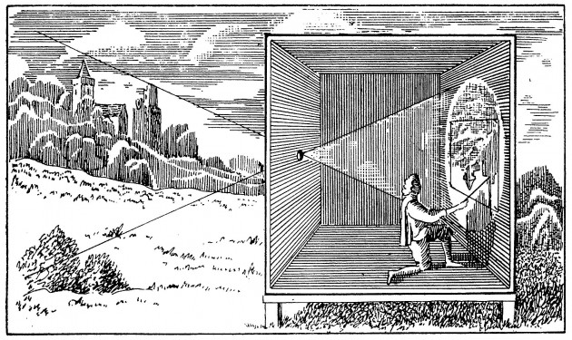
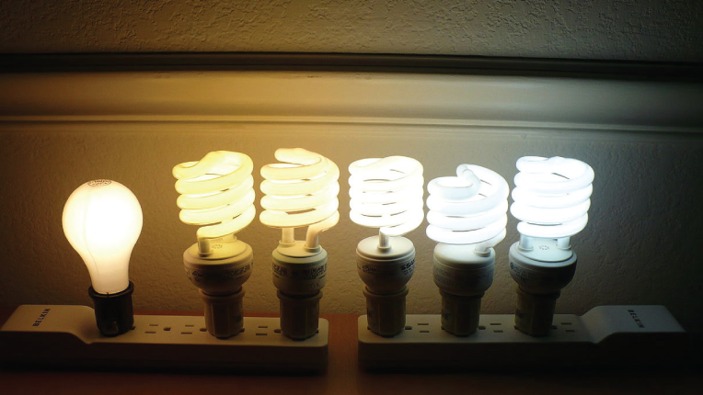
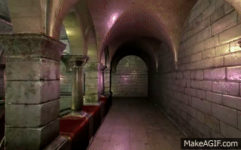
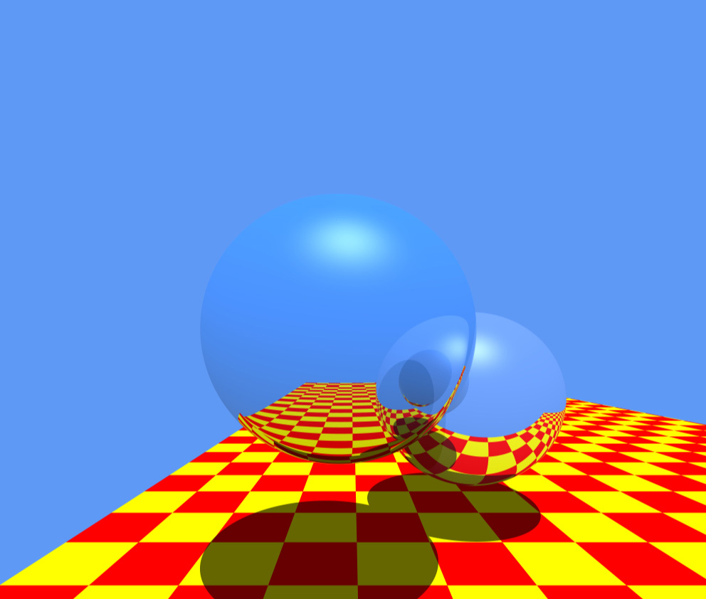
Rendering = geometry + radiometry
geometry/projection
for pin-hole model known since 400BC
radiometrically accurate simulation
is important for photorealism
OpenGL
Raytracing
[Stachowiak 2010]
[Whitted 1980]
camera obscura
[photo credit: videomaker.com June 2015]

Slide 9
Rendering = geometry + radiometry
geometry/projection
for pin-hole model known since 400BC
radiometrically accurate simulation
is important for photorealism
OpenGL
Raytracing
[Stachowiak 2010]
[Whitted 1980]
[photo credit: videomaker.com June 2015]

Slide 10
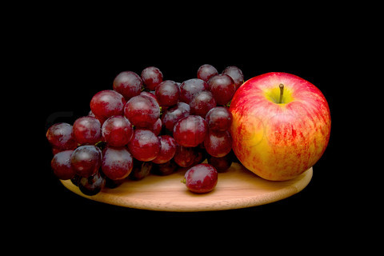
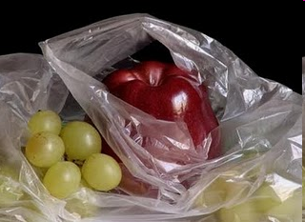

Radiometric fidelity improves photorealism
photograph
manually painted
computer generated
Colourbox.com
Pedro Campos

Slide 11

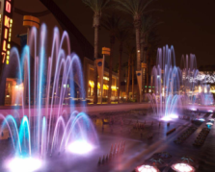
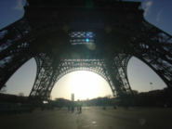



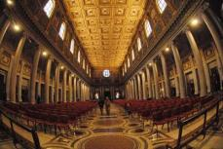
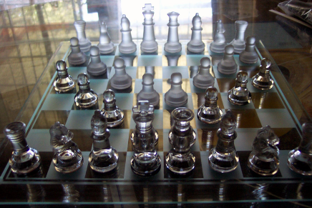
Simulating the physics of light is challenging
defocus
exposure time
lenses
light, media
materials

Slide 12


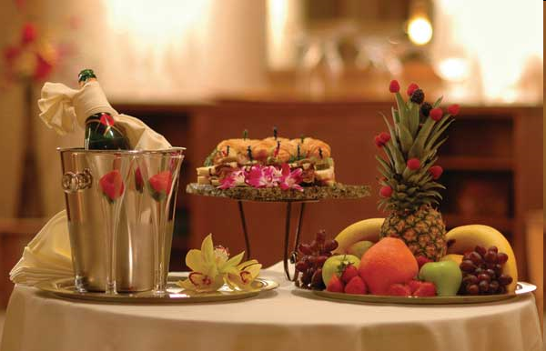
Light transport
virtual
light emitter
virtual
camera
Image ?
virtual scene: geometry + materials
estimate incident radiance at all pixels
on the virtual sensor
exitant radiance
W
m² Sr

Slide 13








Each reflection is modeled by an integration
radiance:

Slide 14
Each reflection is modeled by an integration
radiance:

Slide 15
Each reflection is modeled by an integration
radiance:

Slide 16
Recursive integrals
virtual
light emitter
virtual
camera
Image ?

Slide 17

Recursive integrals
virtual
light emitter
virtual
camera
Image ?

Slide 18
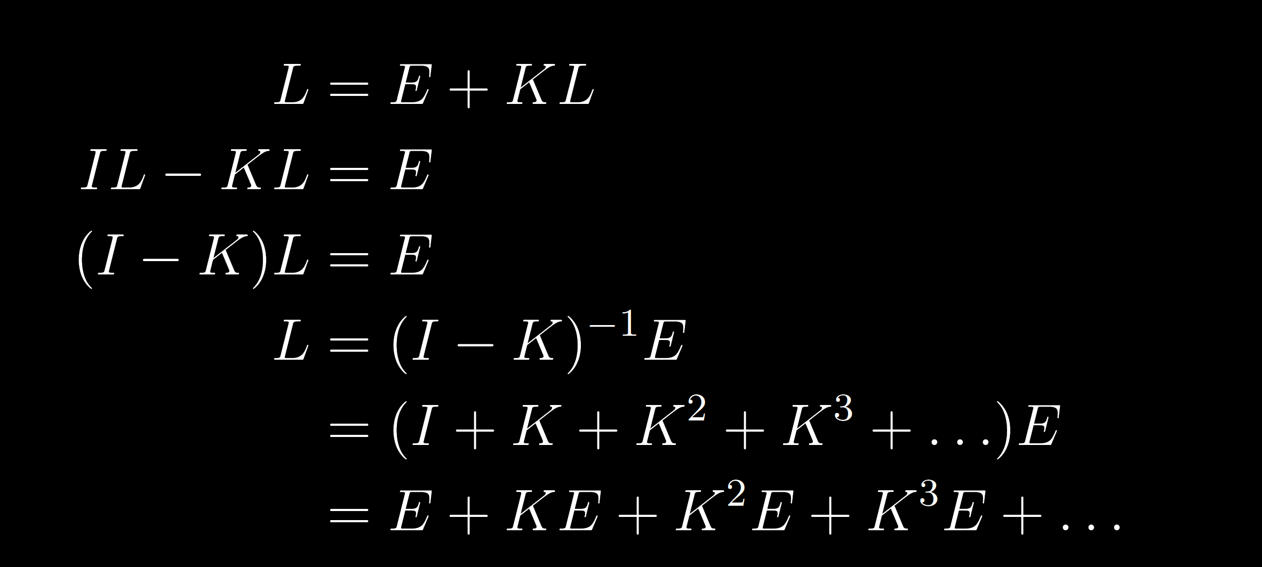
Light transport: recursive integral equation
radiance
emitted radiance
integral operator
The Rendering equation [Kajiya 86]
Light Transport Operators [Arvo 94]

Slide 19
L is a sum of high-dimensional integrals
radiance
integral operator
emitted radiance
One bounce
Three bounces

Slide 20
Reconstruction and integration in rendering

Slide 21

Reconstruction: estimate image samples
ground truth (high-res) image
reconstruct on (low-res) pixel grid
Y
Y
X
X

Slide 22
Naïve method: sample image at grid locations
ground truth (high-res) image
reconstruct on (low-res) pixel grid
Y
Y
sampling
copy
X
X

Slide 23
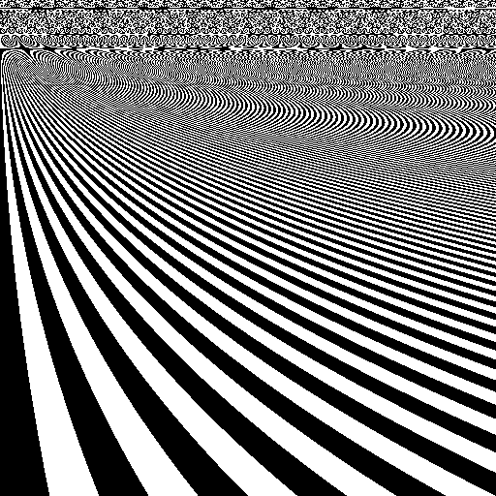
Naïve method: when sampling is increased
ground truth (high-res) image
reconstruct on (low-res) pixel grid
aliasing
Y
Y
X
X

Slide 24
Antialiasing: assuming `square’ pixels
Y
Y
multi-sampling
average
X
X

Slide 25
Antialiasing is costly due to multi-sampling
Y
Y
X
X

Slide 26
Antialiasing using general reconstruction filter
Y
Y
multi-sampling
weighted
average
X
X

Slide 27
Rendering: Reconstructing integrals
Y
multi-sampling
for reconstruction
deterministic
X
Notes:
connect eith prev slide

Slide 28

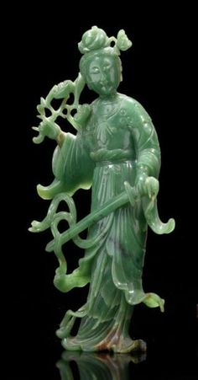
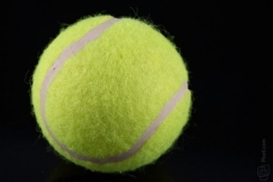
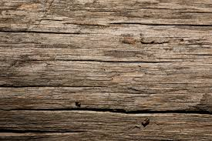
Rendering: Reconstructing integrals
path 1
Y
path 2
multi-sampling
for reconstruction
multi-path sampling
for integration
estimate per sampled pixel
path 3
estimate
(probabilistic for Monte Carlo)
X
Notes:
connect eith prev slide

Slide 29
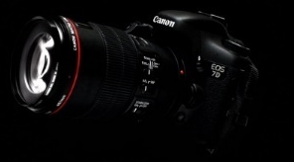
Function-space view: Sampling in path space
each sample represents a path
and has an associated radiance value
light
light paths
camera
n-dimensional path space
Notes:
3 trillion paths and 16D

Slide 30
Sample locations shown in path-pixel space
n-dimensional path space
pixels on sensor
Notes:
Figure from SIGG course notes

Slide 31
Rendering = integration + reconstruction
path-space integration
(projection)
n-dimensional path space
pixel value (radiance)
reconstruction using
integrated radiance
pixels on sensor
pixels on sensor
Notes:
Figure from SIGG course notes. cite Mitchell, dipppe wold cook, etc

Slide 32
Frequency analysis of lightfields in rendering
local variation of integrand
reconstruction filter
path-space integration
(projection)
pixel value (radiance)
n-dimensional path space
integrated radiance
local variation/
anisotropy?
use in regression/reconstruction
[Ramamoorthi et al. 04]
[Durand et al. 05]
[Soler et al. 2009]
[Overbeck et al. 2009]
[Egan et al. 2009, 2011]
[Ramamoorthi et al. 2012]
pixels on sensor
pixels on sensor

Slide 33
Freq. analysis of MC sampling: This course!
Assessing MSE, bias, variance and convergence
of Monte Carlo estimators as a function of the
Fourier spectrum of the sampling function.
n-dimensional path space
local variation/
anisotropy?
[Durand 2011]
[Ramamoorthi et al. 12]
[Subr and Kautz 2013]
[Pilleboue et al. 2015]
pixels on sensor
Notes:
Ravi’s spelling

Slide 34
Freq. analysis of MC sampling: This course!
Assessing MSE, bias, variance and convergence
of Monte Carlo estimators as a function of the
Fourier spectrum of the sampling function.
n-dimensional path space
[Durand 2011]
[Ramamoorthi et al. 12]
[Subr and Kautz 2013]
[Pilleboue et al. 2015]

Slide 35
Freq. analysis of MC sampling: This course!
Assessing MSE, bias, variance and convergence
of Monte Carlo estimators as a function of the
Fourier spectrum of the sampling function.
n-dimensional path space
local variation/
anisotropy?
[Durand 2011]
[Ramamoorthi et al. 12]
[Subr and Kautz 2013]
[Pilleboue et al. 2015]

Slide 36
Freq. analysis of MC sampling: This course!
Assessing MSE, bias, variance and convergence
of Monte Carlo estimators as a function of the
Fourier spectrum of the sampling function.
n-dimensional path space
[Durand 2011]
[Ramamoorthi et al. 12]
[Subr and Kautz 2013]
[Pilleboue et al. 2015]

Slide 37
Freq. analysis of MC sampling: This course!
Assessing MSE, bias, variance and convergence
of Monte Carlo estimators as a function of the
Fourier spectrum of the sampling function.
n-dimensional path space
local variation/
anisotropy?
[Durand 2011]
[Ramamoorthi et al. 12]
[Subr and Kautz 2013]
[Pilleboue et al. 2015]

Slide 38

Rendering = integration + reconstruction
Shiny ball in motion
Shiny ball, out of focus
…
…
image
location
multi-dim integral
Integrand: radiance (W m⁻² Sr⁻¹)
Domain: shutter time x aperture area x 1st bounce x 2nd bounce
…

Slide 39


The problem in 1D
0
Notes:
So, we want to compute the integral of f(x) (shown in yellow). What if f(x) was discretized and stored in an array?
http://www.sciweavers.org/free-online-latex-equation-editor

Slide 40


the sampling function
integrand
sampled integrand
sampling function
multiply
Notes:
What I called the sampled integrand is simply the product of the function and the sampling function, in this case a regular grid, or a piece of the Dirac comb or Shah function.
http://www.sciweavers.org/free-online-latex-equation-editor

Slide 41
sampling function decides integration quality
integrand
sampled function
sampling function
multiply
Notes:
It turns out, that this sampling function is vital in deciding the quality of numerical integration. There are two fundamental ways to improve this sampling function.

Slide 42
strategies to improve estimators
1. modify weights
2. modify locations
eg. quadrature rules, importance sampling, jittered sampling, etc.
Notes:
move eg =s to the middle

Slide 43
insight into impact: Fourier domain
1. modify weights
2. modify locations
analyse sampling function in Fourier domain
Notes:
bring fourier chunk after this

Slide 44


Fourier analysis: origin and intuition
Eigenfunction of the differential operator
Turns differential equations into algebraic equations
scaling
Notes:
\frac {\mathrm d} {\mathrm {d}x} e^{\lambda x} = \lambda e^{\lambda x}
f(x) = \sum\limits_{i=1}^N e^{\lambda_i x}, \quad \frac {\mathrm d} {\mathrm {d}x} f(x) = \sum\limits_{i=1}^N \lambda_i e^{\lambda_i x}

Slide 45

Fourier analysis: origin and intuition
Eigenfunction of the differential operator
Turns differential equations into algebraic equations
if
scaling
projection
Notes:
\frac {\mathrm d} {\mathrm {d}x} e^{\lambda x} = \lambda e^{\lambda x}
f(x) = \sum\limits_{i=1}^N e^{\lambda_i x}, \quad \frac {\mathrm d} {\mathrm {d}x} f(x) = \sum\limits_{i=1}^N \lambda_i e^{\lambda_i x}

Slide 46
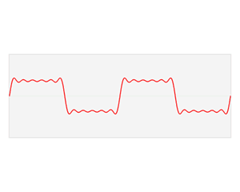
The Fourier domain
Image credit: Wikipedia
Notes:
\hat{f}(\omega) = \int\limits_{-\infty}^{\infty} f(x) e^{-2\pi \mathrm{\imath} \omega x} \mathrm{d}x

Slide 47

The continuous Fourier transform
Fourier
domain
primal
(space, time, etc.)
domain
Notes:
\hat{f}(\omega) = \int\limits_{-\infty}^{\infty} f(x) e^{-2\pi \mathrm{\imath} \omega x} \mathrm{d}x

Slide 48

The Fourier transform: `frequency’ domain
frequency
domain
frequency
projection onto sin and cos
Notes:
\hat{f}(\omega) = \int\limits_{-\infty}^{\infty} f(x) e^{-2\pi \mathrm{\imath} \omega x} \mathrm{d}x
\hat{f}(\omega) = \int\limits_{-\infty}^{\infty} f(x) \cos ({2\pi \omega x}) \mathrm{d}x + \mathrm{\imath} \int\limits_{-\infty}^{\infty} f(x) \sin ({2\pi \omega x}) \mathrm{d}x

Slide 49




A single sample:
phase
amplitude = 1
frequency
Notes:
\hat{f}(\omega) = \int\limits_{-\infty}^{\infty} f(x) e^{-2\pi \mathrm{\imath} \omega x} \mathrm{d}x
\hat{f}(\omega) = \int\limits_{-\infty}^{\infty} f(x) \cos ({2\pi \omega x}) \mathrm{d}x + \mathrm{\imath} \int\limits_{-\infty}^{\infty} f(x) \sin ({2\pi \omega x}) \mathrm{d}x

Slide 50
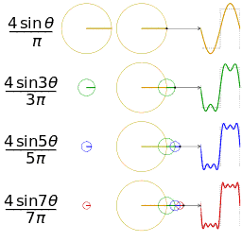
Fourier series: replace integral with sum
approximating a square wave using 4 sinusoids
Notes:
\hat{f}(\omega) = \int\limits_{-\infty}^{\infty} f(x) e^{-2\pi \mathrm{\imath} \omega x} \mathrm{d}x

Slide 51
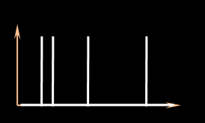


Fourier spectrum of the sampling function
amplitude (sampling spectrum)
sampling function
frequency
phase (sampling spectrum)
Notes:
To abstract away these approaches, we analyse the estimators based on the signature of the sampling function in the Fourier domain. eg. This plot shows the amplitude (yellow) and phase (blue) of the sampling signal.

Slide 52
sampling function = sum of Dirac deltas
+
+
+
Notes:
Any unweighted, sampling function can be expressed as the sum of impulses (or Dirac delta functions).

Slide 53

In the Fourier domain …
Fourier transform
Dirac delta
Frequency
Imaginary
amplitude
phase
Real
primal
Fourier
Complex plane
Notes:
The Fourier transform of a Dirac delta function is a constant (amplitude) with a phase that is linear in frequency (before the modulo 2pi)

Slide 54
Review: in the Fourier domain …
Fourier transform
Dirac delta
Frequency
Imaginary
Imaginary
Real
Real
primal
Fourier
Complex plane
Complex plane
Notes:
The Fourier transform of a Dirac delta function is a constant (amplitude) with a phase that is linear in frequency (before the modulo 2pi)

Slide 55
amplitude spectrum is not flat
Fourier transform
=
=
+
+
+
+
+
+
primal
Fourier
Notes:
The sampling spectrum is therefore the sum of several spectra with constant amplitudes. How does this produce non-constant sampling spectra?

Slide 56
sample contributions at a given frequency
1
2
3
4
5
At a given frequency
sampling function
Imaginary
3
5
1
Real
4
2
Complex plane
Notes:
Now imagine adding more impulses. In this case, the five spikes cause five samples on the dotted circle in the complex plane.

Slide 57
the sampling spectrum at a given frequency
sampling spectrum
Complex plane
given frequency
3
5
centroid
1
4
2
Notes:
Due to the linearity of the Fourier transform, the vector sum of these samples (or the centroid) is the resulting sampling spectrum, sliced at a given frequency. The amplitude spectrum is the distance of the centroid to the Origin and the phase describes the angular offset from the real axis.

Slide 58
the sampling spectrum at a given frequency
sampling spectrum realizations
expected centroid
centroid variance
given frequency
Notes:
Over multiple instances of the sampling spectrum, the location of the centroid has an expected value and a variance (or 2D covariance).

Slide 59
expected sampling spectrum and variance
expected amplitude of sampling spectrum
variance of sampling spectrum
DC
frequency
Notes:
Here, the expected amplitude spectrum is shown with a yellow line and the variance (at each frequency) is denoted using an orange blur.

Slide 60
Abstracting sampling strategy using spectra
1. modify weights
2. modify locations
sampling function in the Fourier domain
amplitude (sampling spectrum)
eg. quadrature rules
a. Distribution eg. importance sampling)
frequency
phase (sampling spectrum)
Notes:
To abstract away these approaches, we analyse the estimators based on the signature of the sampling function in the Fourier domain. eg. This plot shows the amplitude (yellow) and phase (blue) of the sampling signal.

Slide 61
stochastic sampling & instances of spectra
realizations of sampling functions
realizations of sampling spectra
Sampler
(Strategy 1)
draw
Fourier
transform
Notes:
Remember that each instance of samples from the sampler produces a different sampling spectrum. Now given the many instances of sampling spectra from two different sampling strategies …

Slide 62
assessing estimators using sampling spectra
Instances of sampling functions
Instances of sampling spectra
Sampler
(Strategy 1)
Which strategy is better? Metric?
Sampler
(Strategy 2)
Notes:
the question we address is how we can compare the strategies, for use in numerical integration. But what is the basis of comparison?

Slide 63
accuracy (bias) and precision (variance)
Estimator 2 is unbiased but has higher variance
frequency
Estimator 1
Estimator 2
estimated value (bins)
reference
Notes:
Given two estimators, we can now compare their respective biases and variances. But can we do such comparisons predictively?

Slide 64
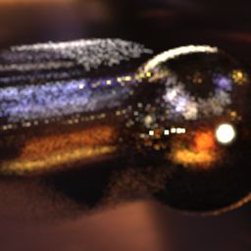

Variance and bias
predict as a function of sampling strategy and integrand
High variance
High bias
Notes:
So, we want to compute the integral of f(x) (shown in yellow). What if f(x) was discretized and stored in an array?
http://www.sciweavers.org/free-online-latex-equation-editor

Slide 65

Monte Carlo integration: summary and error
Error
MSE, bias, variance
convergence rate: error as N is increased
Notes:
\int\limits_0^1 \; f(x) \; \mathrm{d} x \approx \frac 1 N \sum\limits_{i=1}^N f(x_i), \quad x_i \sim \mathrm{Unif}([0,1])

Slide 66


Bird’s-eye view of analysis
Rewrite MC estimator in terms of sampling function
where
Notes:
S(x) = \sum\limits_{i=1}^N \delta(x-x_i)
\frac 1 N \sum\limits_{i=1}^N f(x_i) = \int\limits_0^1 f(x) S(x) \; \mathrm{d}x
S(x) = \frac 1 N \sum\limits_{i=1}^N \delta(x-x_i)
\int\limits_0^1 f(x) S(x) \; \mathrm{d}x = \int\limits_{-\infty}^{\infty} \hat{f}(\omega) \hat{S}(-\omega) \; \mathrm{d}\omega

Slide 67

Bird’s-eye view of analysis
Rewrite MC estimator in terms of sampling function
Fourier transform preserves inner products, so
where
Notes:
S(x) = \sum\limits_{i=1}^N \delta(x-x_i)
\frac 1 N \sum\limits_{i=1}^N f(x_i) = \int\limits_0^1 f(x) S(x) \; \mathrm{d}x
S(x) = \frac 1 N \sum\limits_{i=1}^N \delta(x-x_i)
\int\limits_0^1 f(x) S(x) \; \mathrm{d}x = \int\limits_{-\infty}^{\infty} \hat{f}(\omega) \hat{S}(-\omega) \; \mathrm{d}\omega

Slide 68

Bird’s-eye view of analysis
Rewrite MC estimator in terms of sampling function
Fourier transform preserves inner products, so
Analyse MSE error, bias and convergence in terms of
where
Notes:
S(x) = \sum\limits_{i=1}^N \delta(x-x_i)
\frac 1 N \sum\limits_{i=1}^N f(x_i) = \int\limits_0^1 f(x) S(x) \; \mathrm{d}x
S(x) = \frac 1 N \sum\limits_{i=1}^N \delta(x-x_i)
\int\limits_0^1 f(x) S(x) \; \mathrm{d}x = \int\limits_{-\infty}^{\infty} \hat{f}(\omega) \hat{S}(-\omega) \; \mathrm{d}\omega

Slide 69
Summary
f
average
S
light transport & integration
high-dimensional sampling
sampling function & spectrum
error prediction

Slide 70
Summary
f
average
S
light transport & integration
high-dimensional sampling
sampling function & spectrum
error prediction

Slide 71
Next
f
average
S
light transport & integration
high-dimensional sampling
sampling function & spectrum
error prediction
Wojciech
Gurprit

Slide 72
Local variation is useful for adaptive sampling
path-space integration
(projection)
pixel value (radiance)
n-dimensional path space
integrated radiance
local variation/
anisotropy?
use in regression/reconstruction
pixels on sensor
pixels on sensor
Notes:
Figure from SIGG course notes

